Slide 1
ENPM 667 Control of Robotic Systems Project 1
Presentation on topic:
Feedback Linearization vs. Adaptive Sliding Mode Control for a Quadrotor Helicopter
Aim: To study and compare two different approaches for controlling a highly coupled nonlinear system(quadrotor)
Journal paper: Daewon Lee, H. Jin Kim, and Shankar Sastry, “Feedback Linearization vs. Adaptive Sliding Mode Control for a Quadrotor Helicopter”, International Journal of Control, Automation, and Systems (2009) 7(3):419-428.

Slide 2
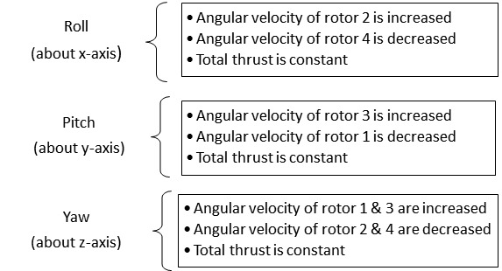
Quadcopter Dynamics
Why is Quadcopter an underactuated system?
4 Inputs
Rotor Thrust (F1, F2, F3 & F4)
6 Variables to control
X and Roll
Y and Pitch
Z and Yaw

Slide 3
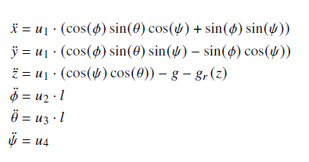
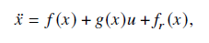
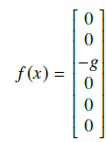
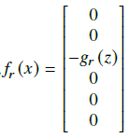
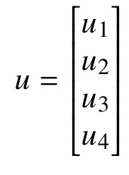
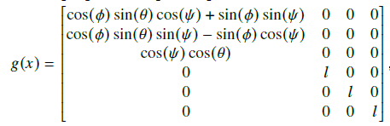
Dynamic Equations of the Quadcopter
Here g_{r}(z) is the grounding effect given by:

Slide 4
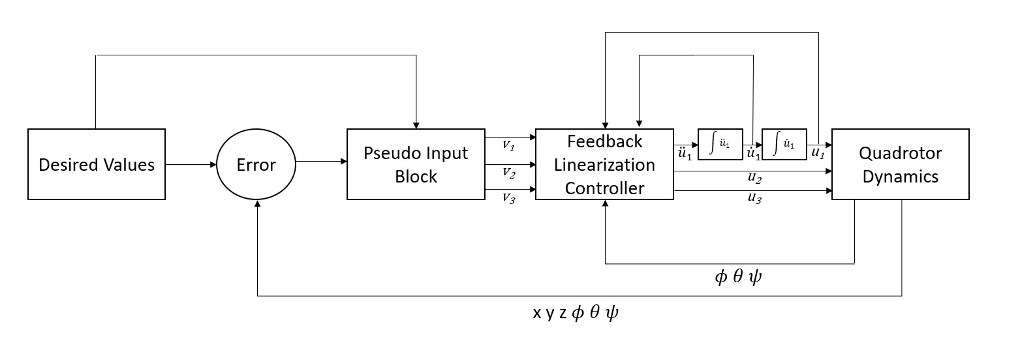
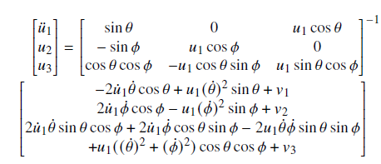
Feedback Linearization Control
*

Slide 5
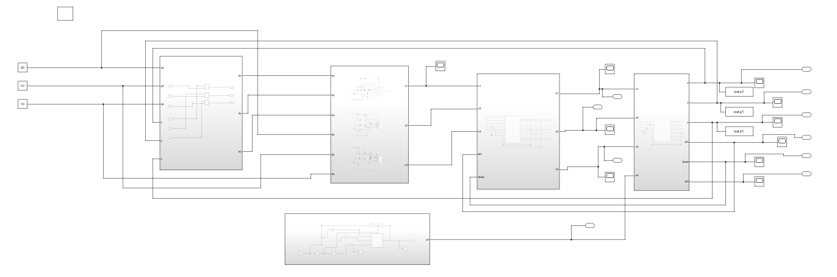
Feedback Linearization Control – Simulation on MATLAB Simulink
The Control System

Slide 6
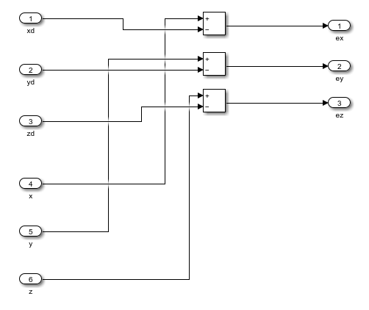
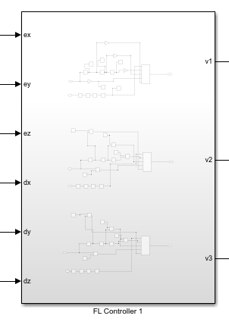
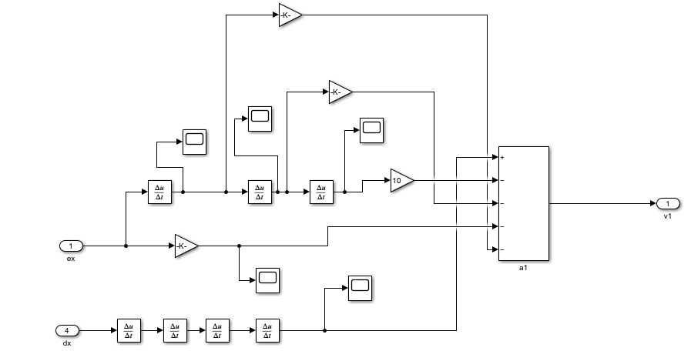
Block to generate error
Block to generate pseudo input: v1, v2 and v3

Slide 7
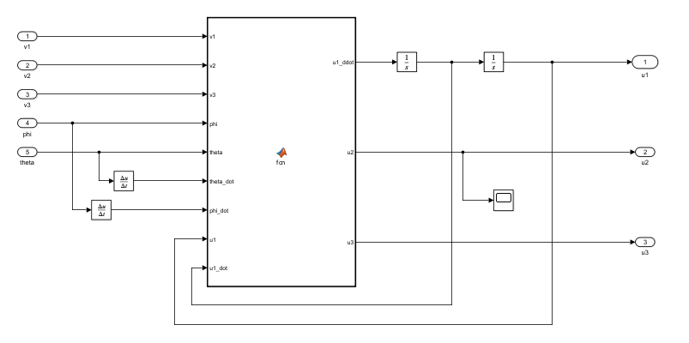
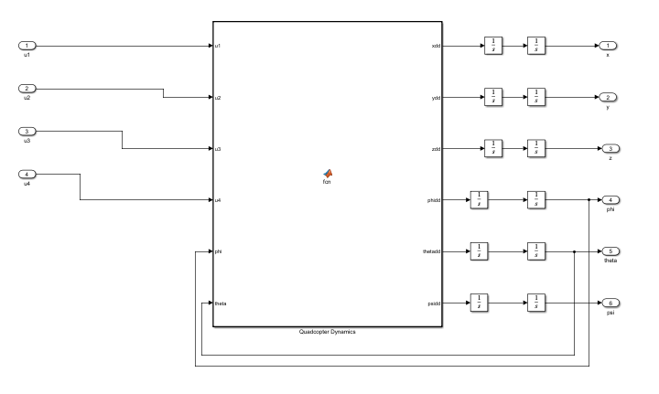
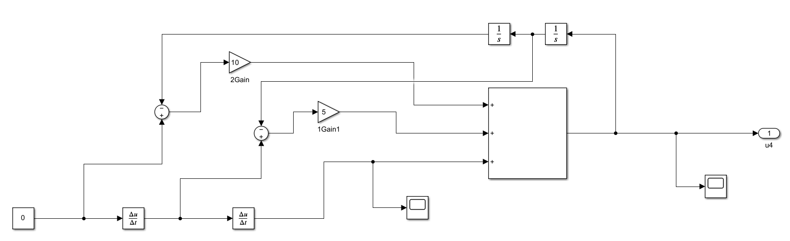
Feedback Linearization Controller Block
Quadcopter Dynamics Block
Yaw Control PD Controller Block

Slide 8
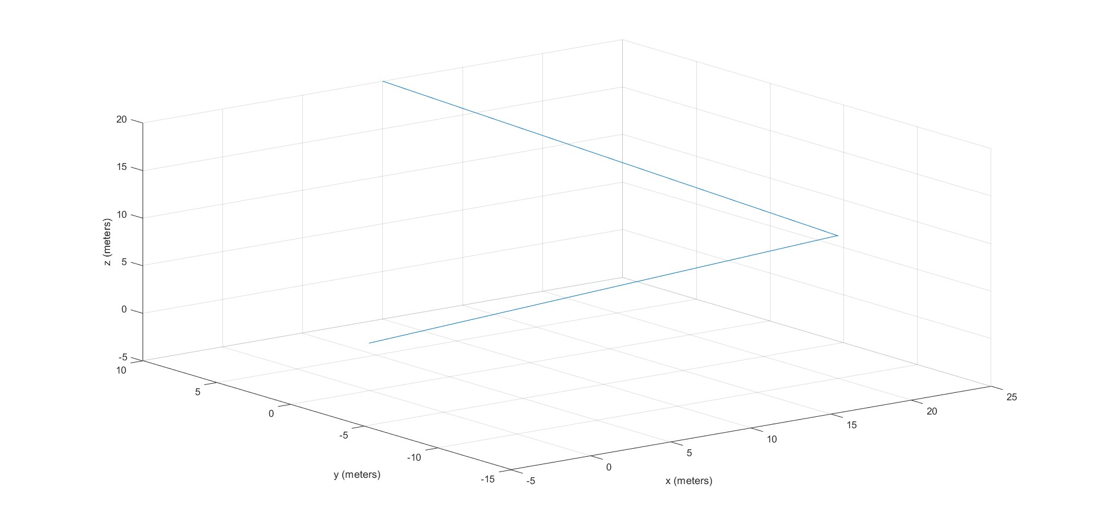
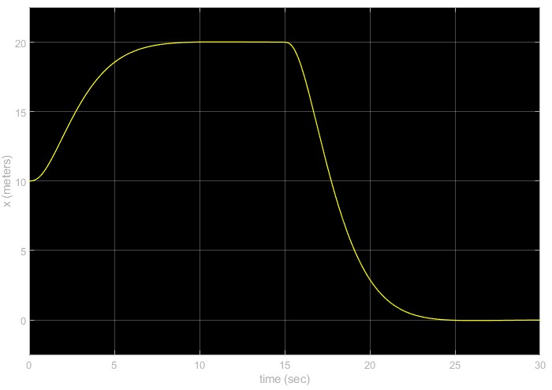
Results Obtained
(10,10,20)
(20,-10,10)
(0,0,0)
X trajectory plot (from error dynamics)
3d Plot of the quadcopter trajectory (from error dynamics)

Slide 9
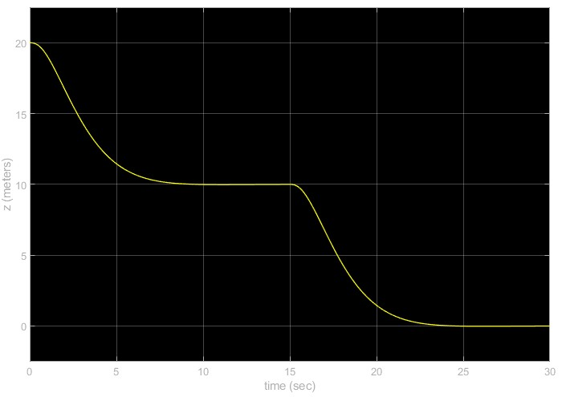
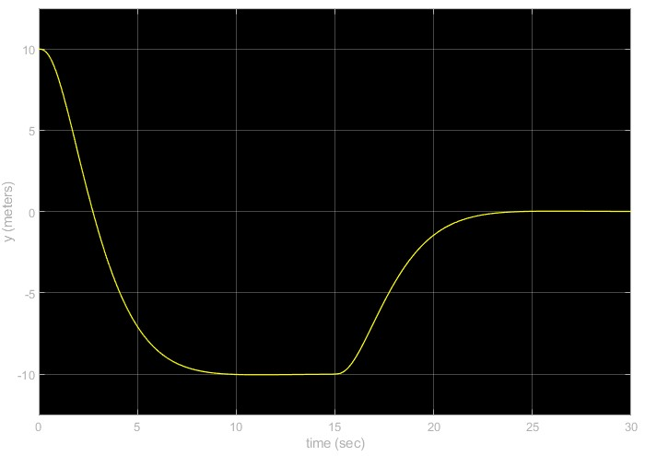
Results Obtained
Y trajectory plot (from error dynamics)
Z trajectory plot (from error dynamics)

Slide 10
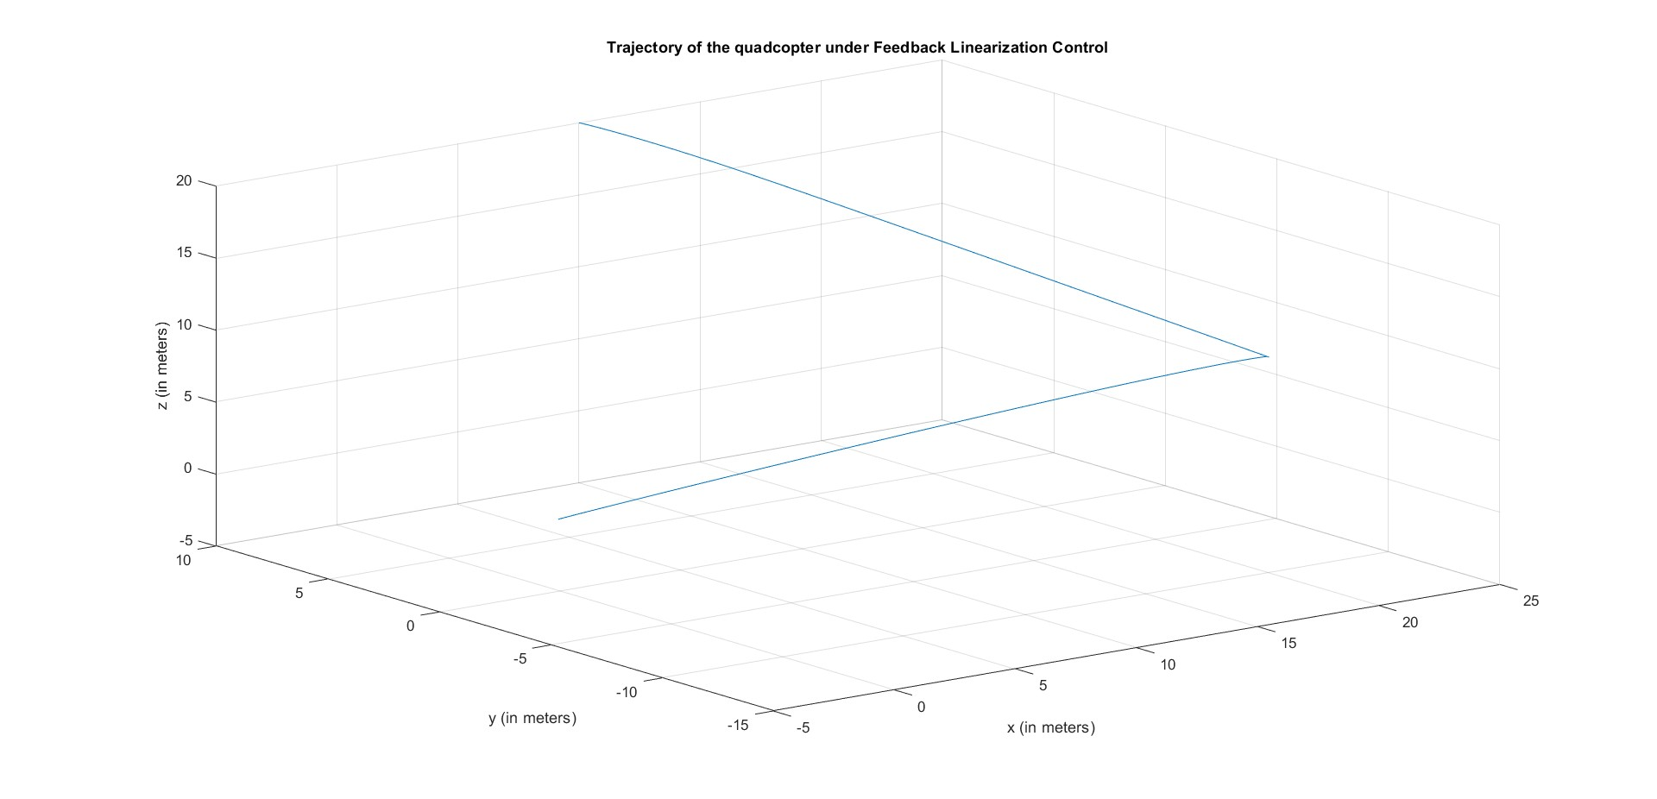
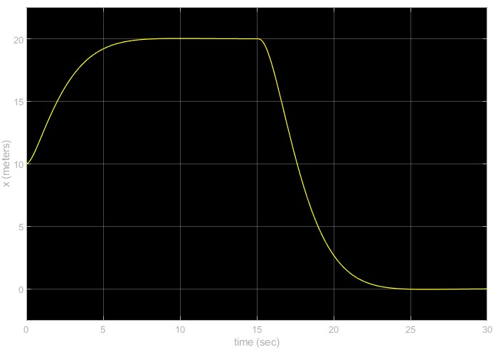
Results Obtained
X trajectory value obtained from quadcopter dynamics
3d Plot of the quadcopter trajectory (obtained from system dynamics)

Slide 11
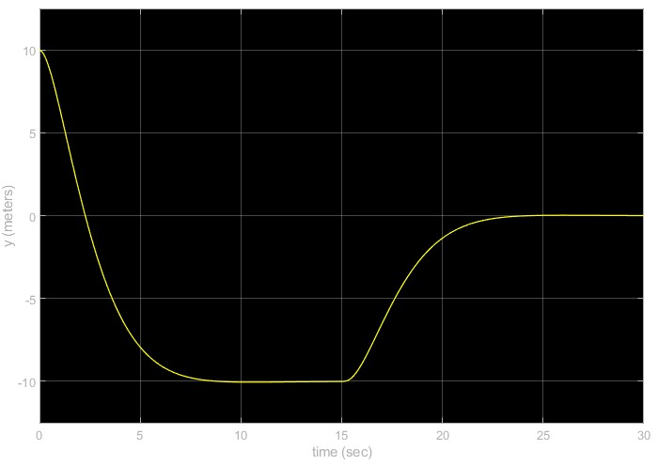
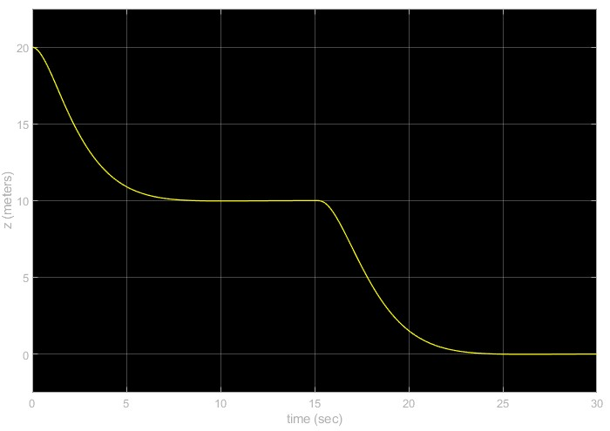
Results Obtained
Y trajectory plot obtained from quadcopter dynamics
Z trajectory value obtained from quadcopter dynamics

Slide 12
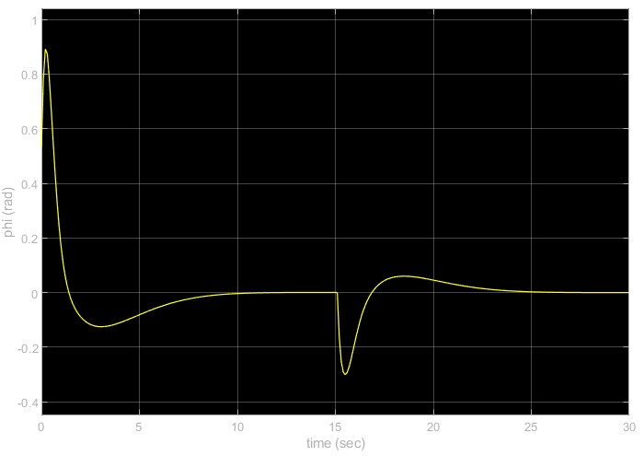
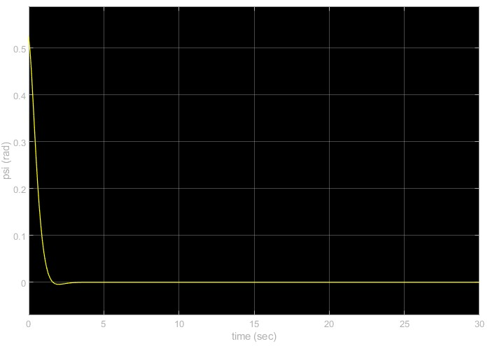
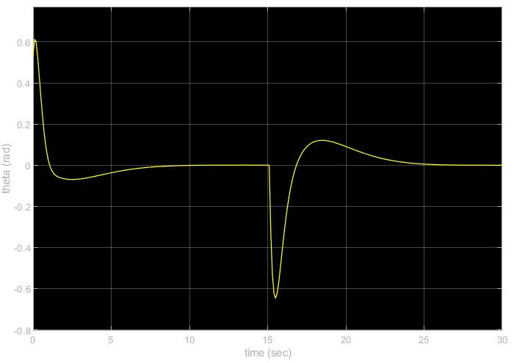
Results Obtained
Angle Phi
Angle Psi
Angle Theta

Slide 13
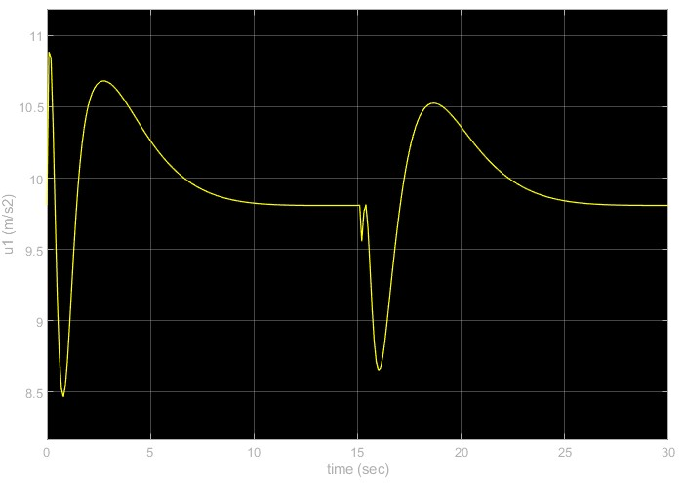
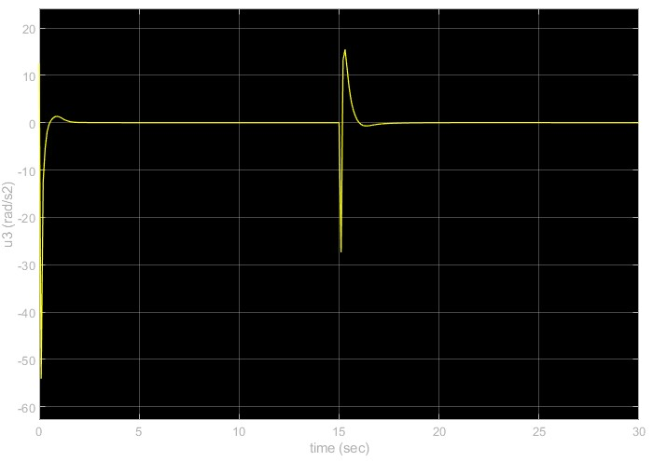
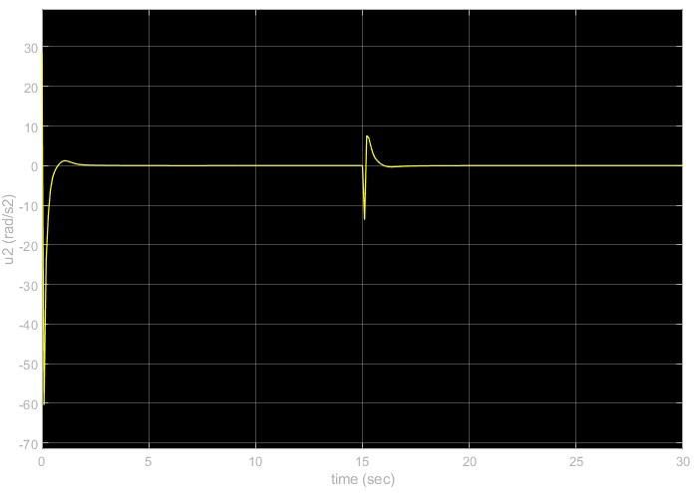
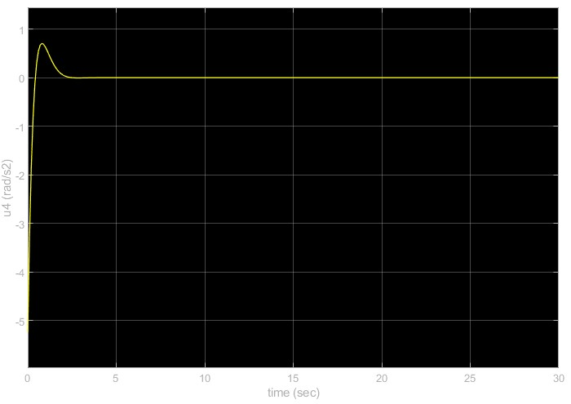
u1
u3
u2
u4

Slide 14
Slide Description
Slides 2 and 3 explains the dynamics of the quadcopter and why it is a highly coupled underactuated system
Slide 4 gives an introduction about the concept of Feedback Linearization
Slides 5 to 7 gives an overview of different subsystems used in Simulink to simulate the model.
Slides 8 and 9 gives the desired trajectory of the quadcopter obtained from the quadcopter error dynamics.
Slides 10 to 13 shows the various system parameters during of simulation. Slides 10 and 11 displaces the trajectory obtained from quadcopter dynamics. We can observe that the trajectory followed by the quadcopter exactly matches with the trajectory given in the paper and with the trajectory obtained from error dynamics, hence proving the exactitude of our simulation.
Slides 12 and 13 shows the attitude values of the quadcopter and the inputs generated by the controllers, respectively.

Slide 15
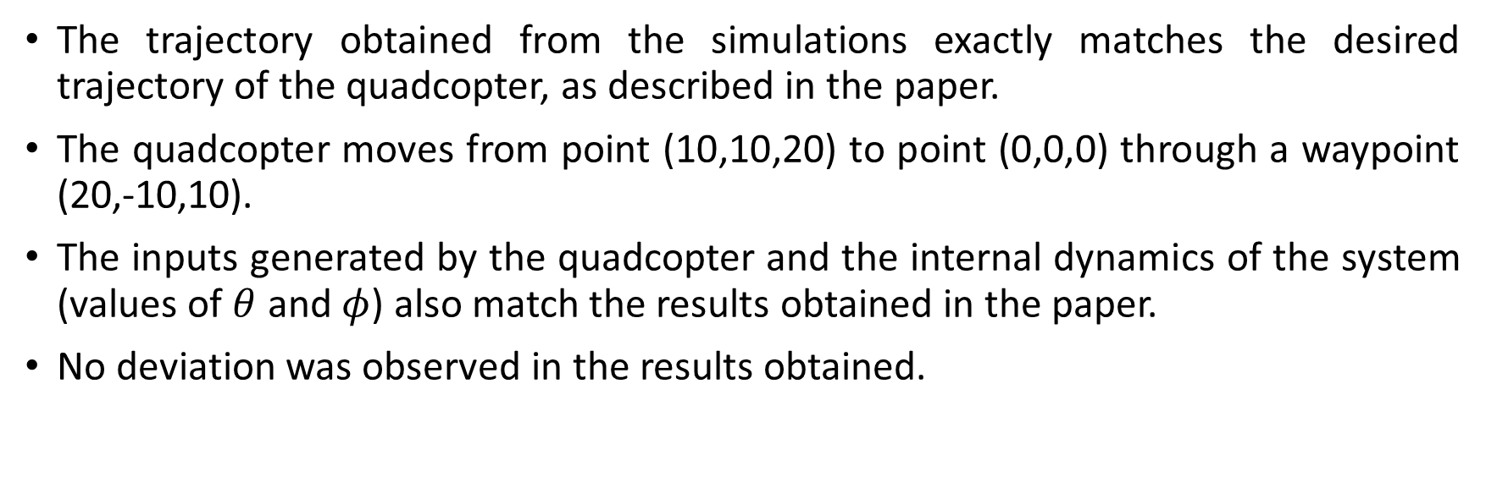
Results and Deviation
The trajectory obtained from the simulations exactly matches the desired trajectory of the quadcopter, as described in the paper.
The quadcopter moves from point (10,10,20) to point (0,0,0) through a waypoint (20,-10,10).
The inputs generated by the quadcopter and the internal dynamics of the system (values of $θ$ and $φ$) also match the results obtained in the paper.
No deviation was observed in the results obtained.

Slide 16
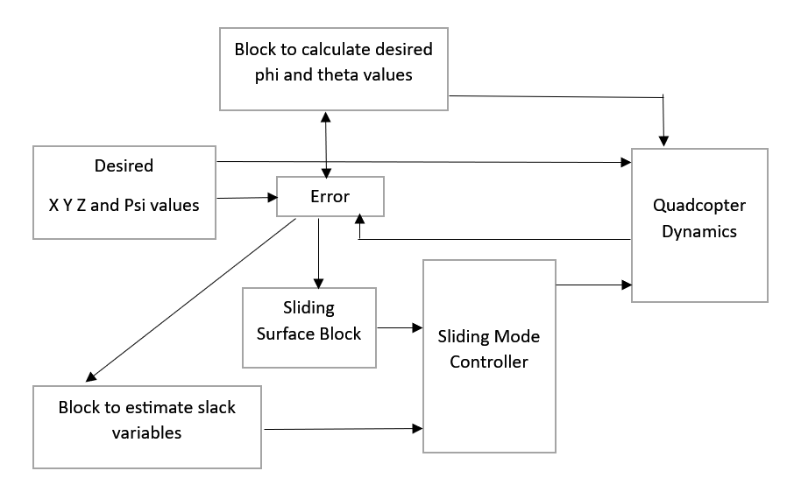
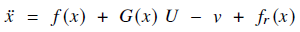
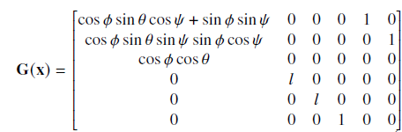
Adaptive Sliding Mode Control

Slide 17
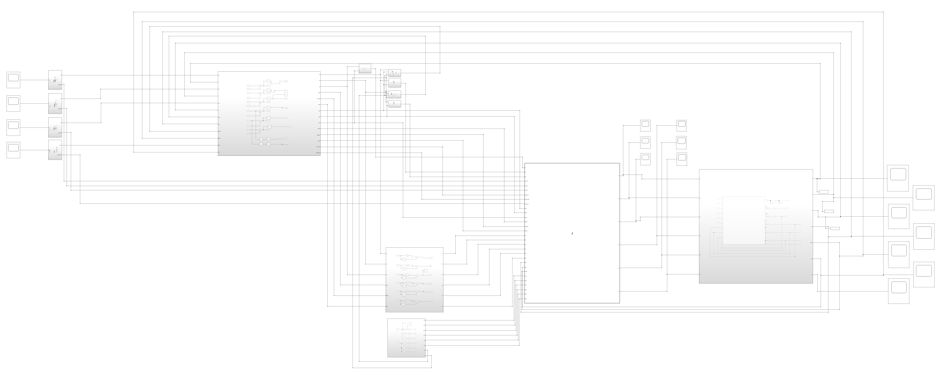
Adaptive Sliding Mode Control
The Control System

Slide 18
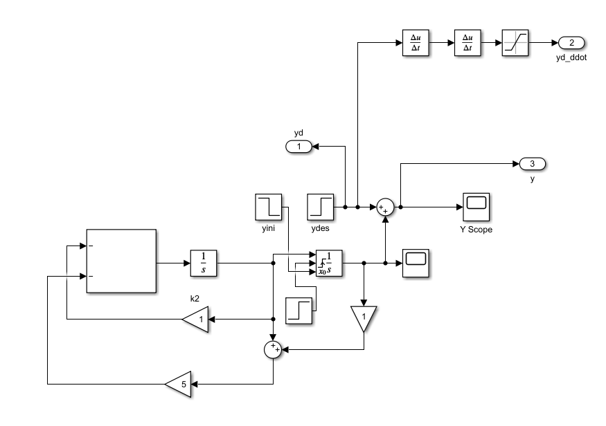
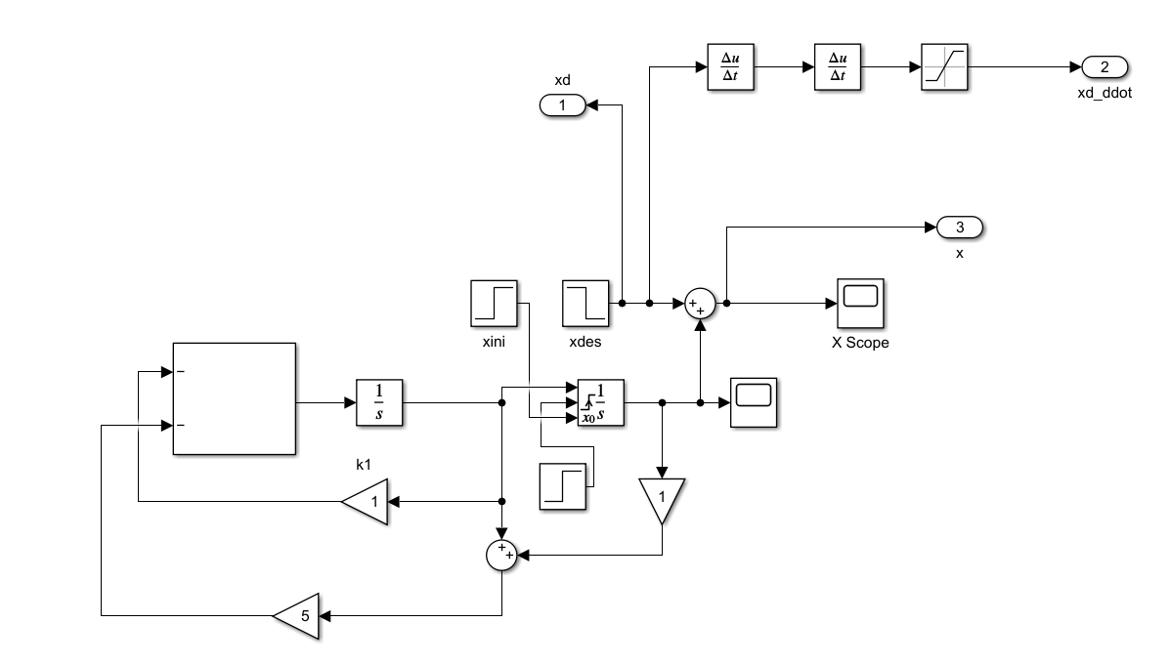
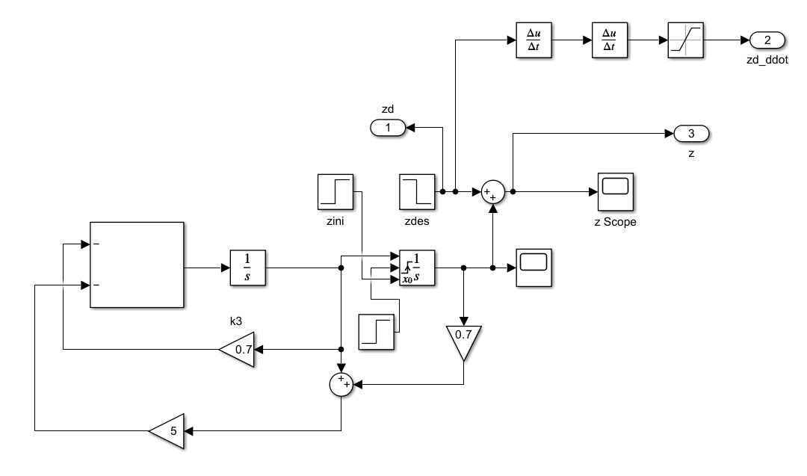
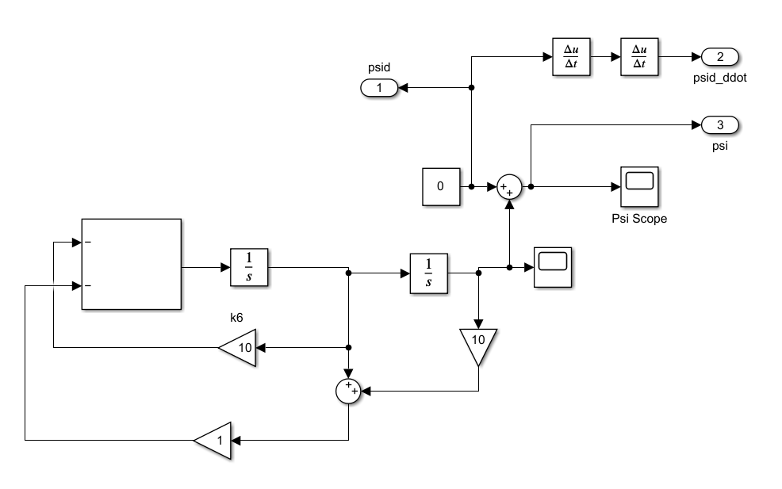
Adaptive Sliding Mode Control
Error Dynamics - x
Error Dynamics - y
Error Dynamics - z
Error Dynamics - phi

Slide 19
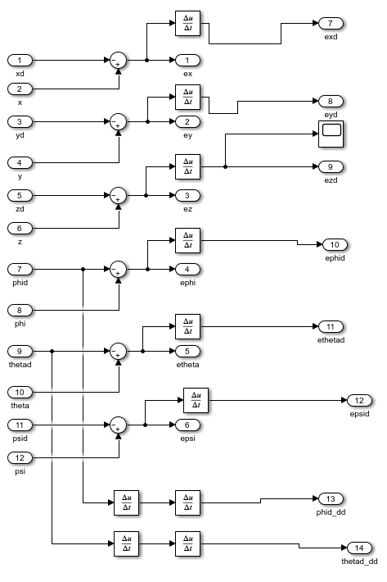
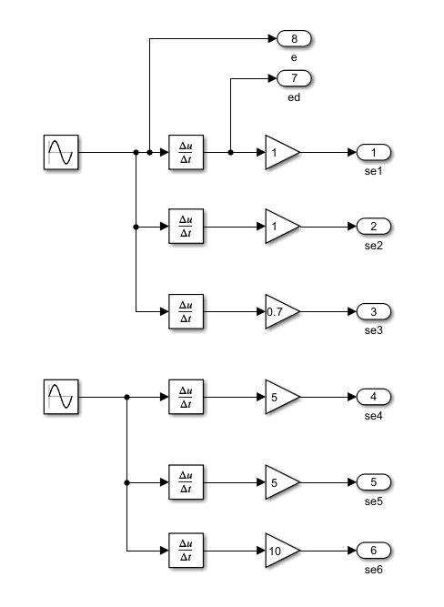
Adaptive Sliding Mode Control
Error Generator Block
Block to mimic sensor noise

Slide 20
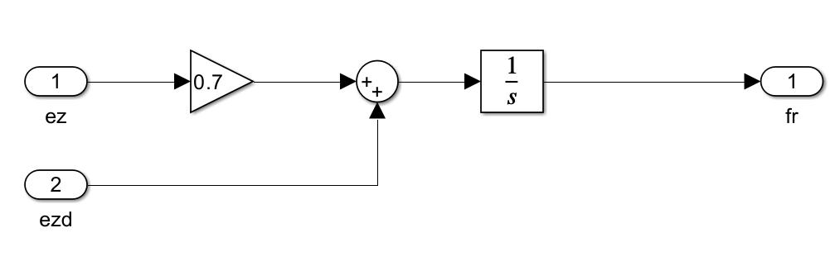
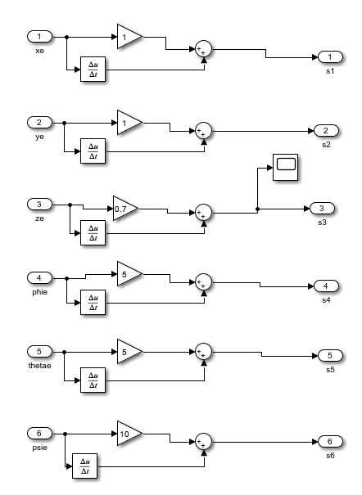
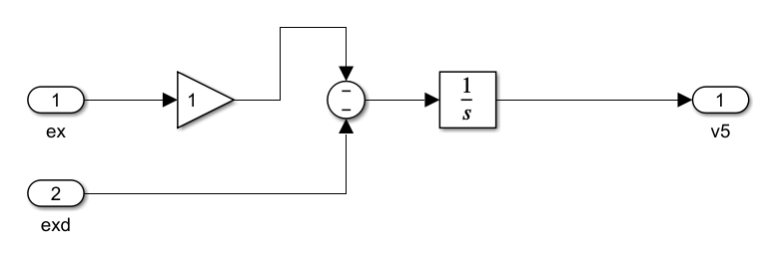
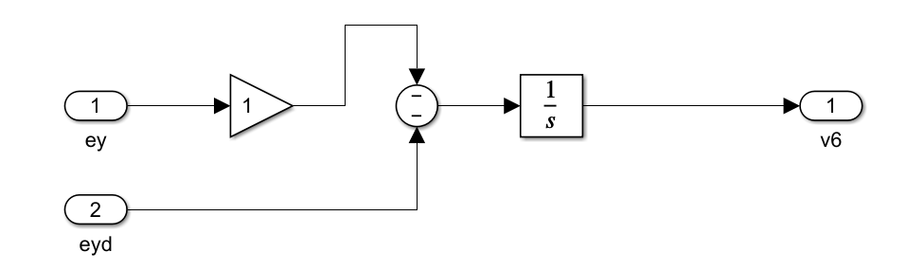
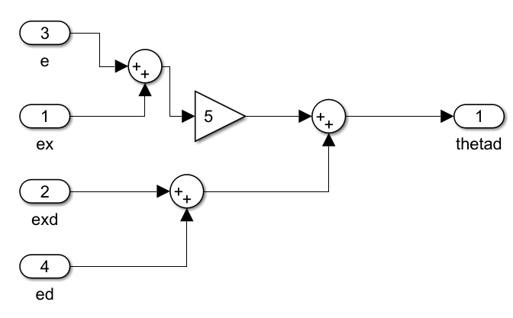
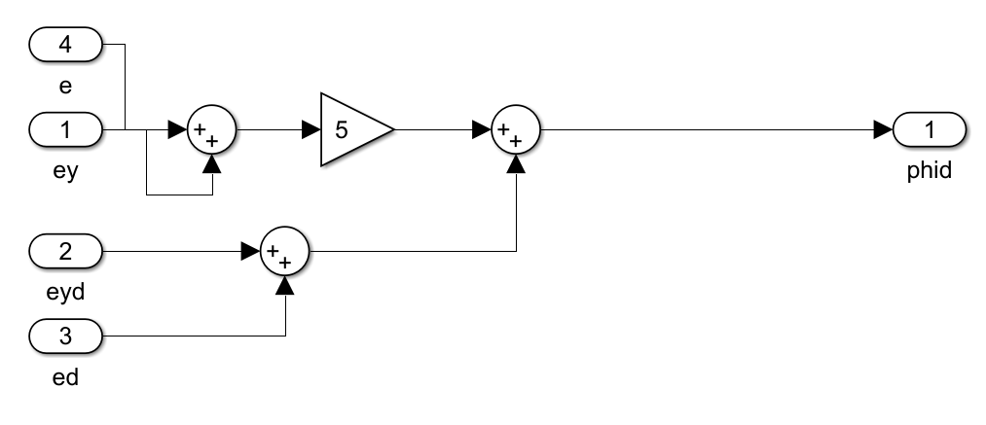
Sliding Surface Block
Block to estimate f_{r} value
Block to estimate v₅ value
Block to estimate v₆ value
Block to find desired theta
Block to find desired phi

Slide 21
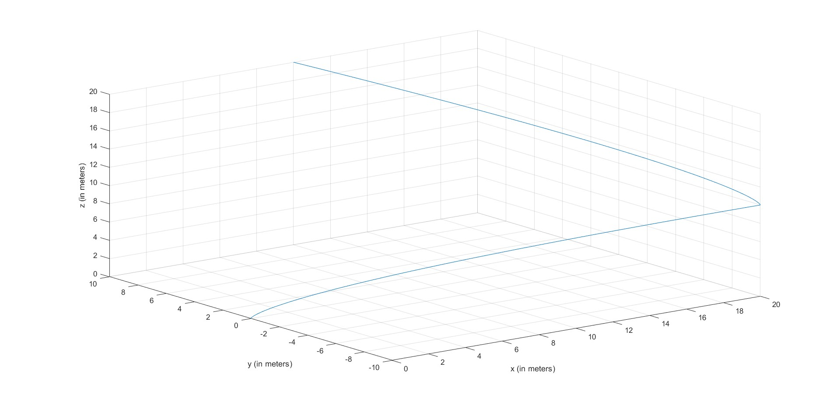
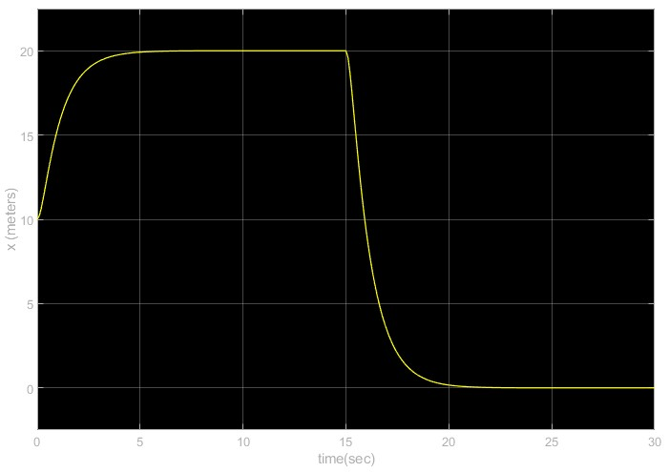
Results : Adaptive sliding Mode Control
X trajectory value obtained from error dynamics
3d plot from trajectory values obtained from error dynamics

Slide 22


Results : Adaptive Sliding Mode Control
Y trajectory value obtained from error dynamics
Z trajectory value obtained from error dynamics

Slide 23

Results : Adaptive sliding Mode Control without Sensor Noise
3d trajectory obtained from quadcopter dynamics

Slide 24


Results : Adaptive sliding Mode Control without Sensor Noise
X trajectory value obtained from quadcopter dynamics
Y trajectory value obtained from quadcopter dynamics

Slide 25


Results : Adaptive sliding Mode Control without Sensor Noise
Z trajectory value obtained from quadcopter dynamics
Phi value obtained from quadcopter dynamics

Slide 26


Results : Adaptive sliding Mode Control without Sensor Noise
Theta value obtained from quadcopter dynamics
Psi value obtained from quadcopter dynamics

Slide 27






Results : Adaptive sliding Mode Control without Sensor Noise
u1
u2
u3
u5
u6
u4

Slide 28

Results : Adaptive sliding Mode Control with Sensor Noise
3d trajectory obtained from quadcopter dynamics

Slide 29


Results : Adaptive sliding Mode Control with Sensor Noise
X trajectory value obtained from quadcopter dynamics
Y trajectory value obtained from quadcopter dynamics

Slide 30


Results : Adaptive sliding Mode Control without Sensor Noise
Z trajectory value obtained from quadcopter dynamics
Phi value obtained from quadcopter dynamics

Slide 31


Results : Adaptive sliding Mode Control without Sensor Noise
Theta value obtained from quadcopter dynamics
Psi value obtained from quadcopter dynamics

Slide 32






Results : Adaptive sliding Mode Control without Sensor Noise
u1
u2
u3
u5
u6
u4

Slide 33
Slide Description
Slide 16 gives an introduction about the Adaptive Sliding Mode control System
Slides 17 to 20 explains how the concept was implemented on MATLAB Simulink for simulation.
Slides 21 and 22 displays the desired trajectory obtained from the error dynamics of the Adaptive Sliding Mode Control System (The concept is further explained in the report).
Slides 23 to 26 gives the 3D trajectory of the quadcopter, the position and attitude values of the quadcopter obtained as an output of quadcopter dynamics, not considering the sensor noise. Slides 28 to 31 gives the same for the system, when sensor noise is introduced.
The trajectories generated from the error dynamics and the trajectories generated from quadcopter dynamics (with and without sensor noise) matches the trajectories given in the journal paper. In all the 3 cases, the quadcopter initially starts from position (10,10,20) and moves to waypoint (20,-10,10) and finally reaches the point (0,0,0).
Slides 27 and 32 goes over the inputs generated by the Adaptive sliding mode controller without and with sensor noise, respectively.
The sensor noise considered for the simulation is a sinusoidal input of frequency 5hz.

Slide 34
Results and Deviation
The trajectory obtained from the error dynamics and the quadcopter dynamics of the Adaptive Sliding Mode Quadcopter Control System matches with the trajectory given in the journal paper.
The attitude graphs are deviating from the graphs given in the journal paper, but the system is reaching its goal without significant effect on the path/trajectory taken.
The Adaptive Sliding mode control simulations were carried out under uncertainties and with/without sensor noise. We can observe that the system is more robust when compared to the feedback linearization control system, which is highly sensitive to noise and disturbances. This is mainly because Sliding mode control system does not involve higher order terms of the state.
This proves a significant advantage of Sliding Mode controllers over Feedback Linearization controllers, which is the main aim of the report.
Hence, we were able to successfully establish that Sliding mode controllers are inherently better than feedback linearization controllers for controlling a highly coupled nonlinear dynamic system like a quadrotor in the presence of sensor noise and external disturbances.

Slide 35
Video Links of the Simulation
Feedback Linearization Control : https://drive.google.com/file/d/1MixbGqmnv_A7-E336NaRtx56od-MZK24/view?usp=sharing
Adaptive Sliding Mode Control without Sensor Noise : https://drive.google.com/file/d/1cYFo4aJkrwVeHFt1jB7zSiMRp8AOiow1/view?usp=sharing
Adaptive Sliding Mode Control with Sensor Noise :
https://drive.google.com/file/d/1VzPEME5Vj8hjPPT3ZS8WmuviCEUT2iwU/view?usp=sharing

Slide 36
Thank You
Suhas Nagaraj (suhas99) – UID: 119505373
Swaraj M Rao (swarajmr) – UID: 120127007

